Slide 1
Ron dorszynski nephew of former pastor Monsignor Julius Dorszynski

Slide 2
Saint Hyacinth​ church roof replacement
Protecting our place of worship

Slide 3
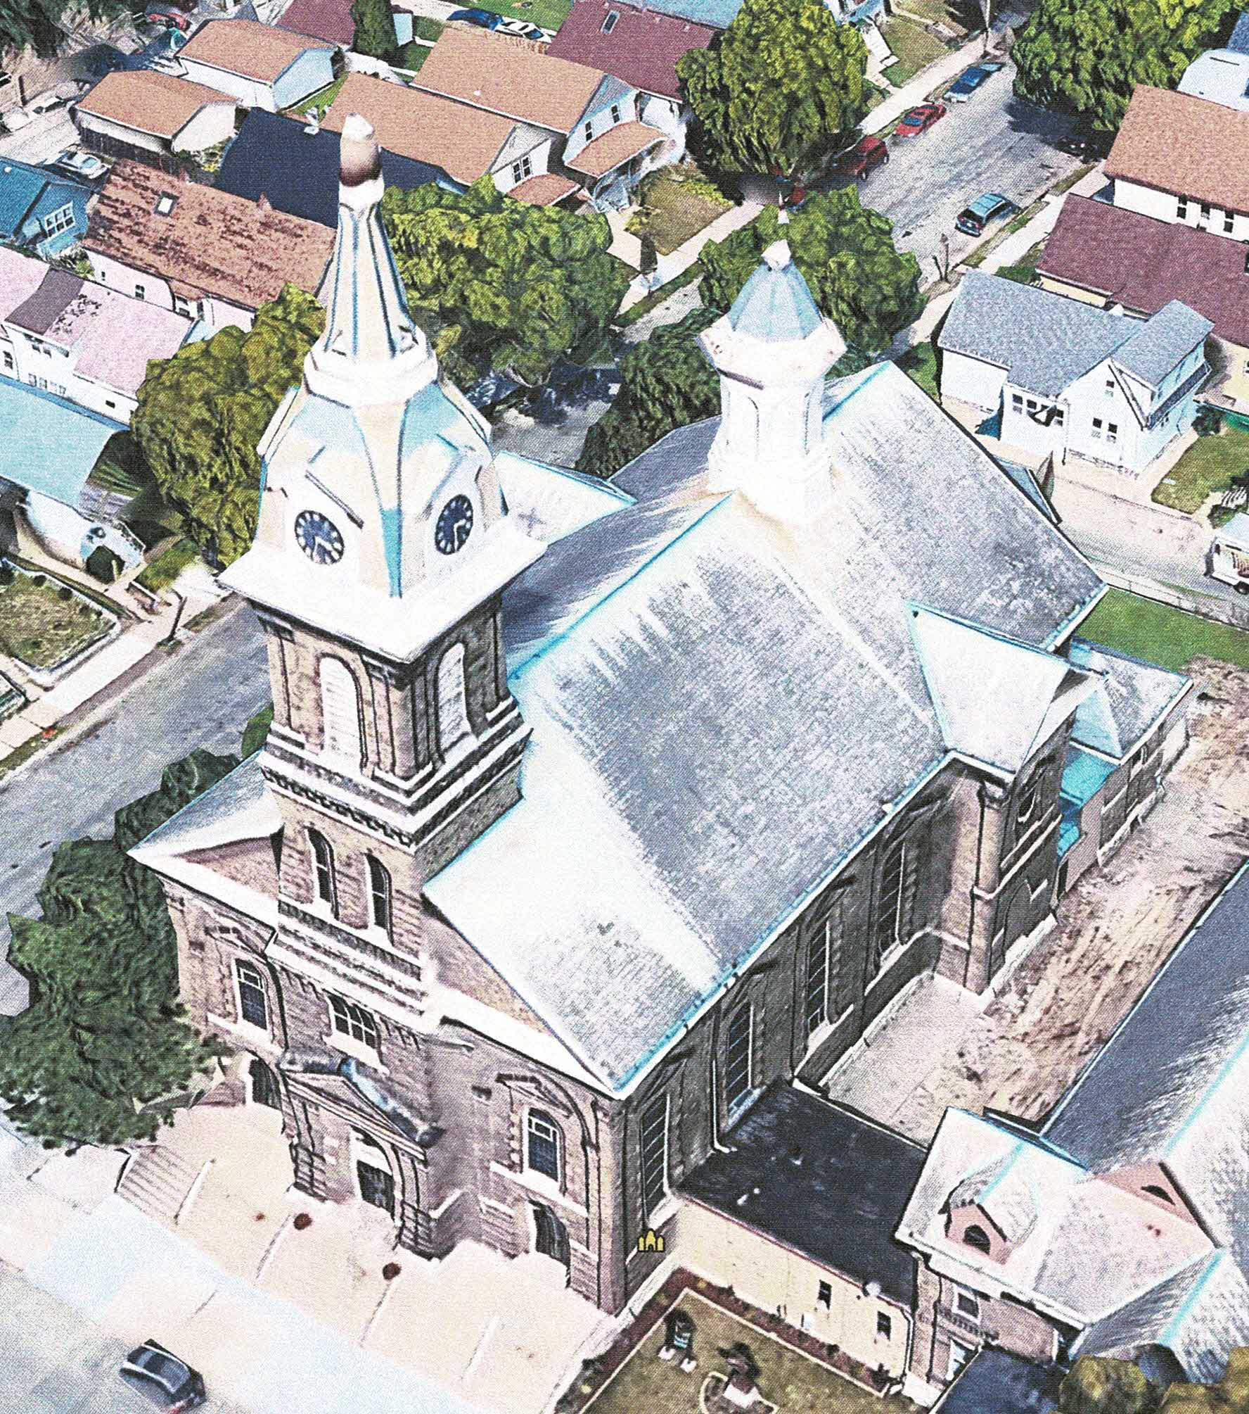
A VIEW FROM ABOVE

Slide 4
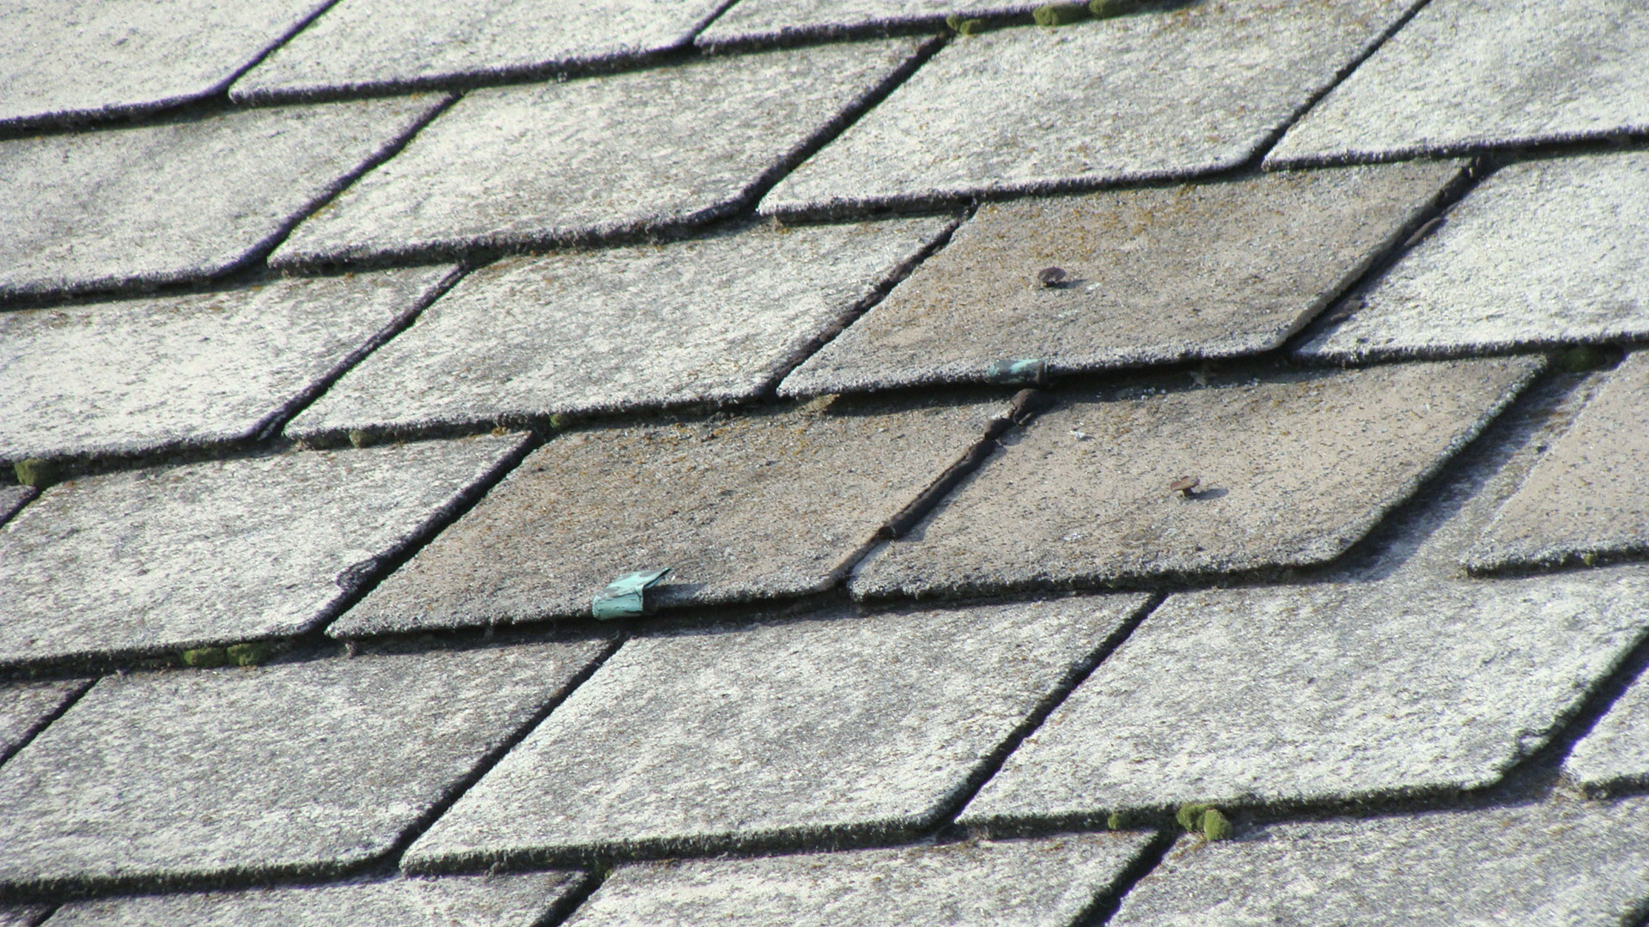
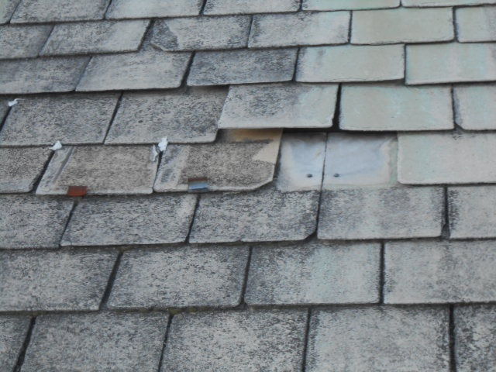
ROOF ESTIMATED TO BE 70 – 80 YEARS OLD
FIELD AREA DEFECTS

Slide 5
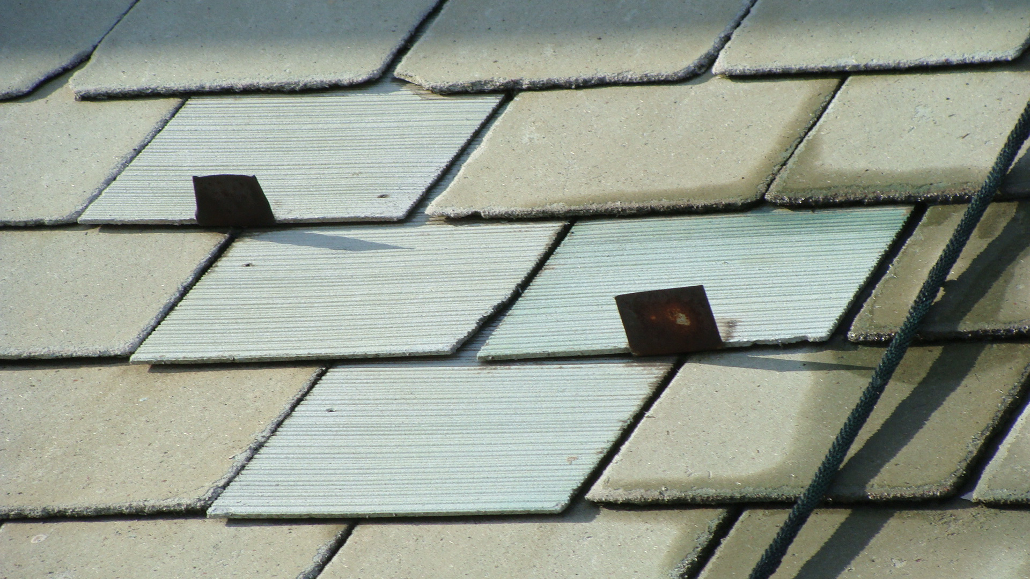
IMPROPER OR FAILING REPARS

Slide 6
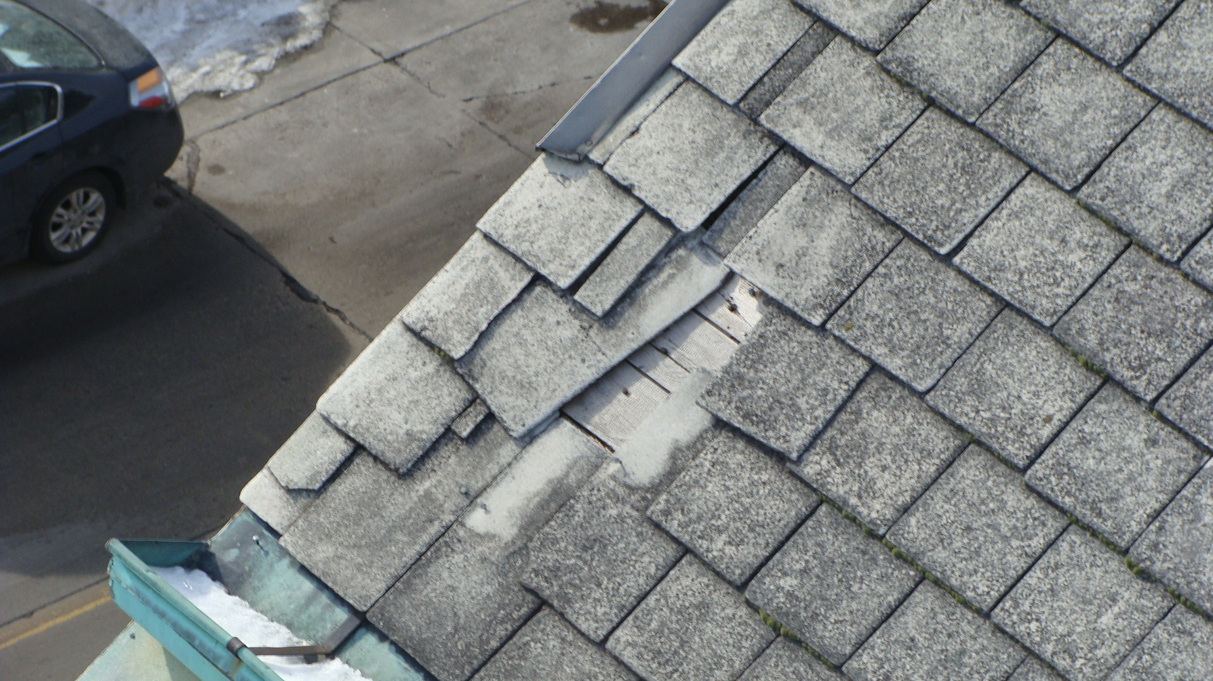
LEAKAGE CAN DAMGE WOOD ROOF DECK AND BUILDING INTERIOR

Slide 7
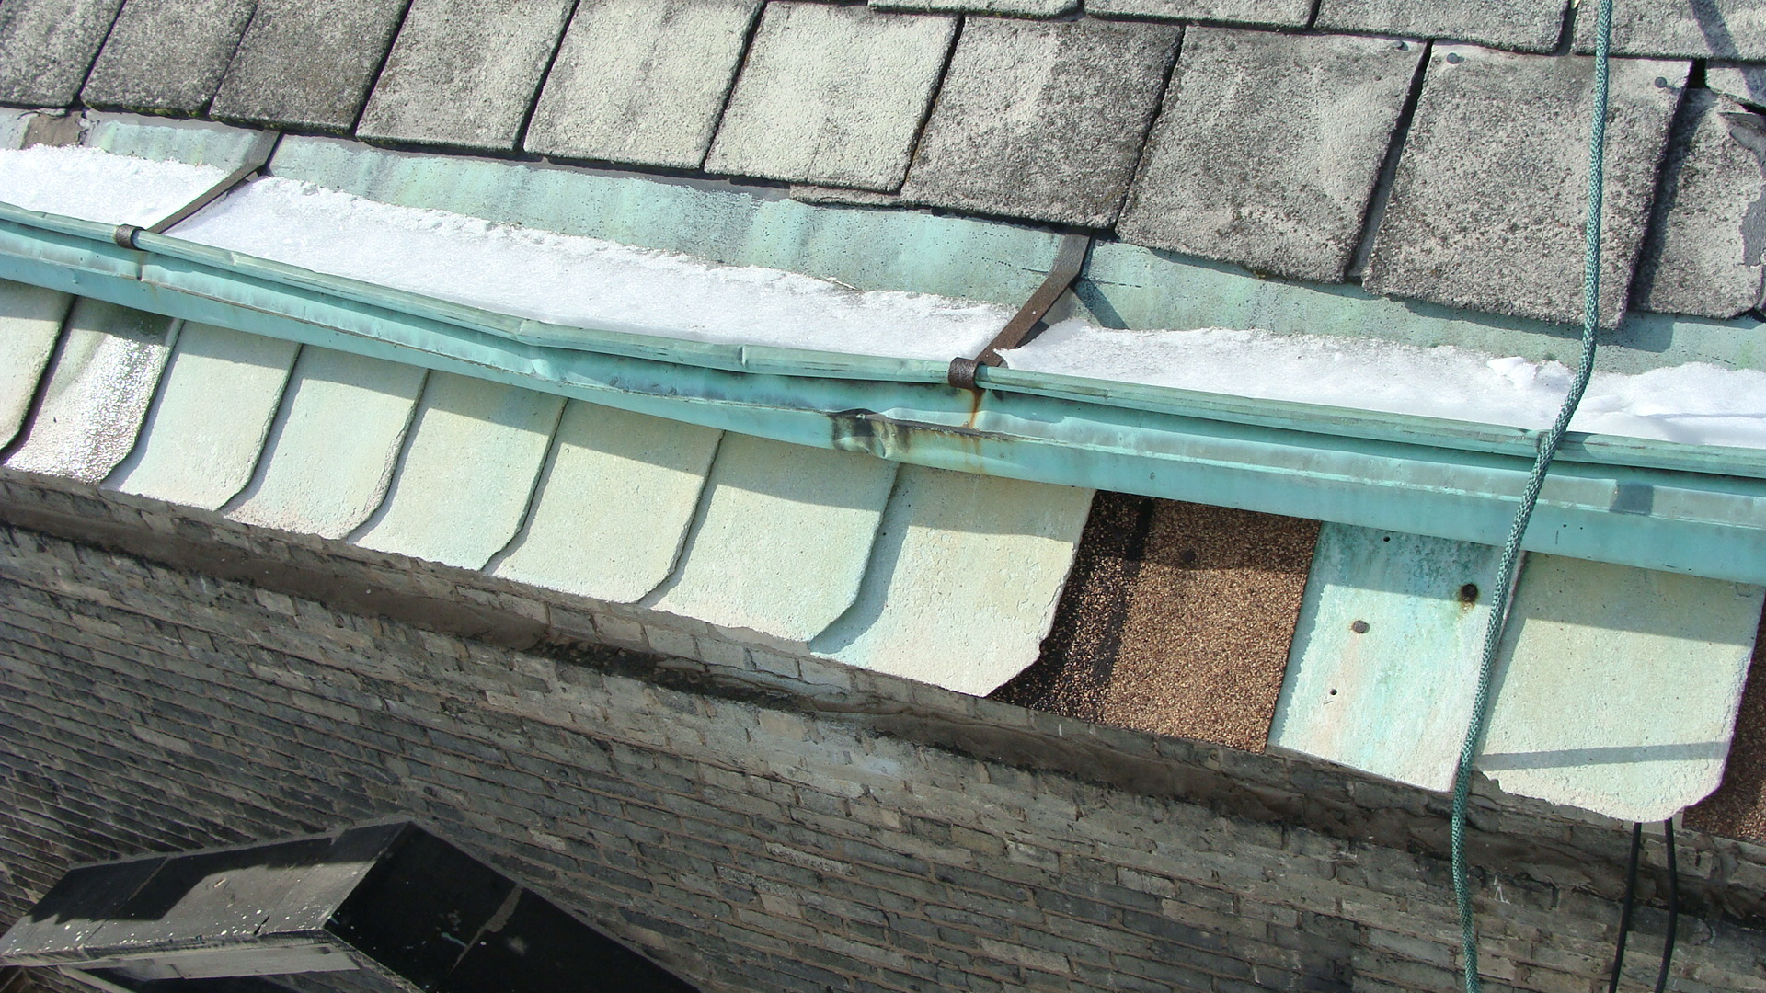
MISSING SHINGLE & DAMAGED GUTTER

Slide 8
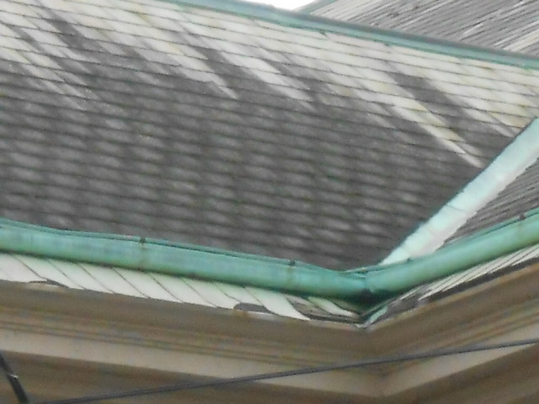
SHINGLE DAMAGE AT VALLEY

Slide 9
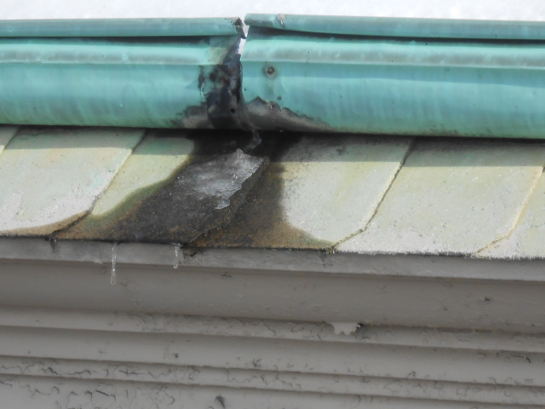
DEFECTIVE GUTTERS

Slide 10
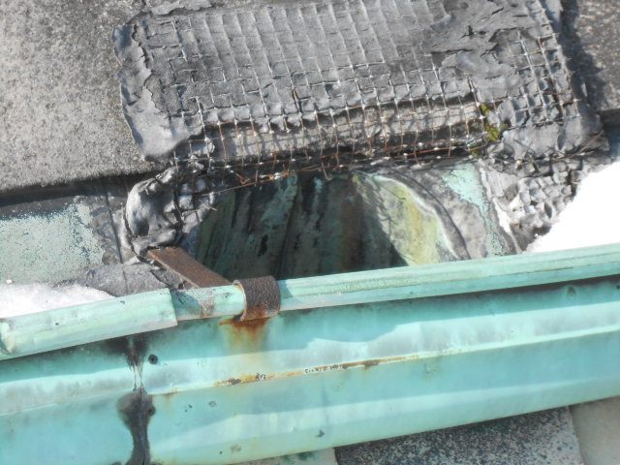
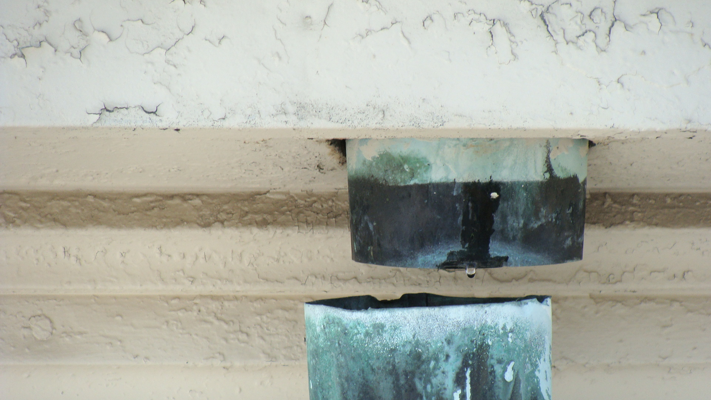
DEFECTIVE OUTLET AND DOWNSPOUT

Slide 11
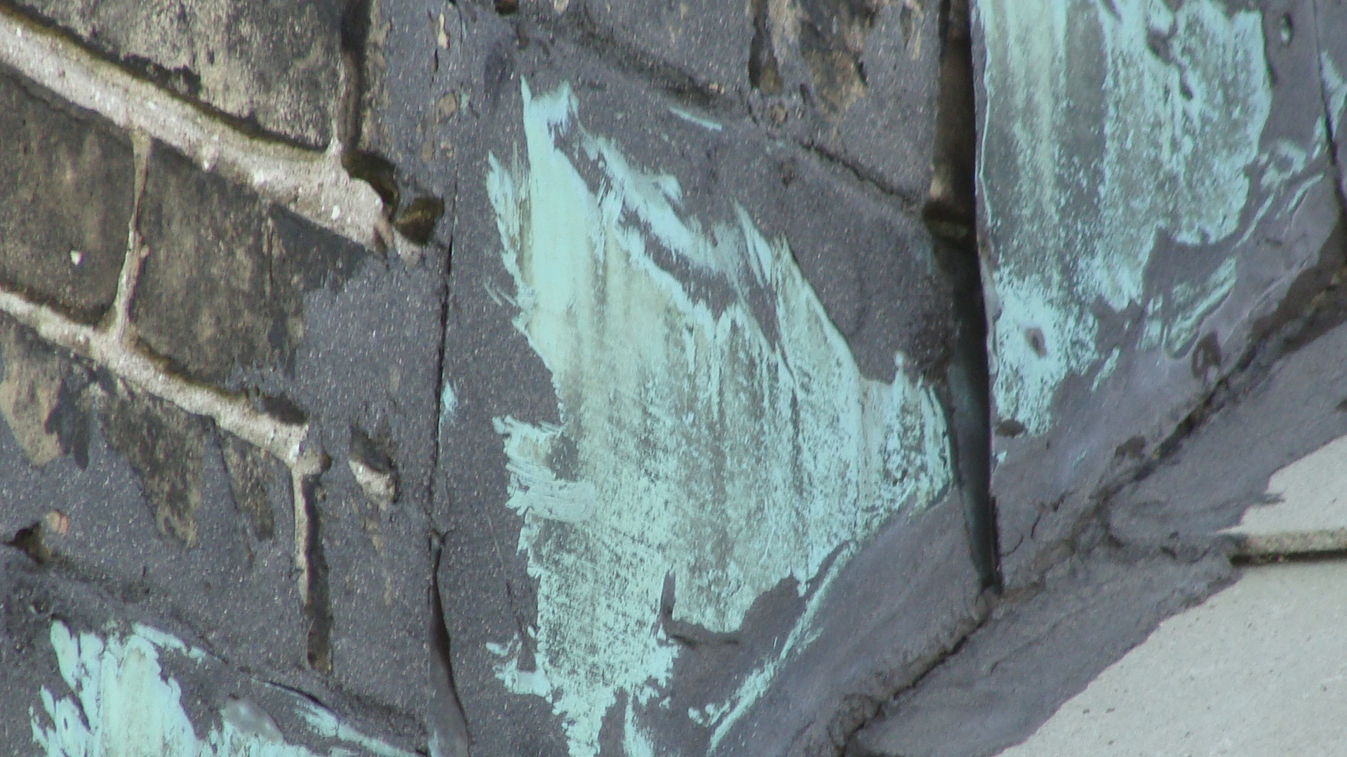
WORN ROOF-TO-WALL FLASHINGS

Slide 12
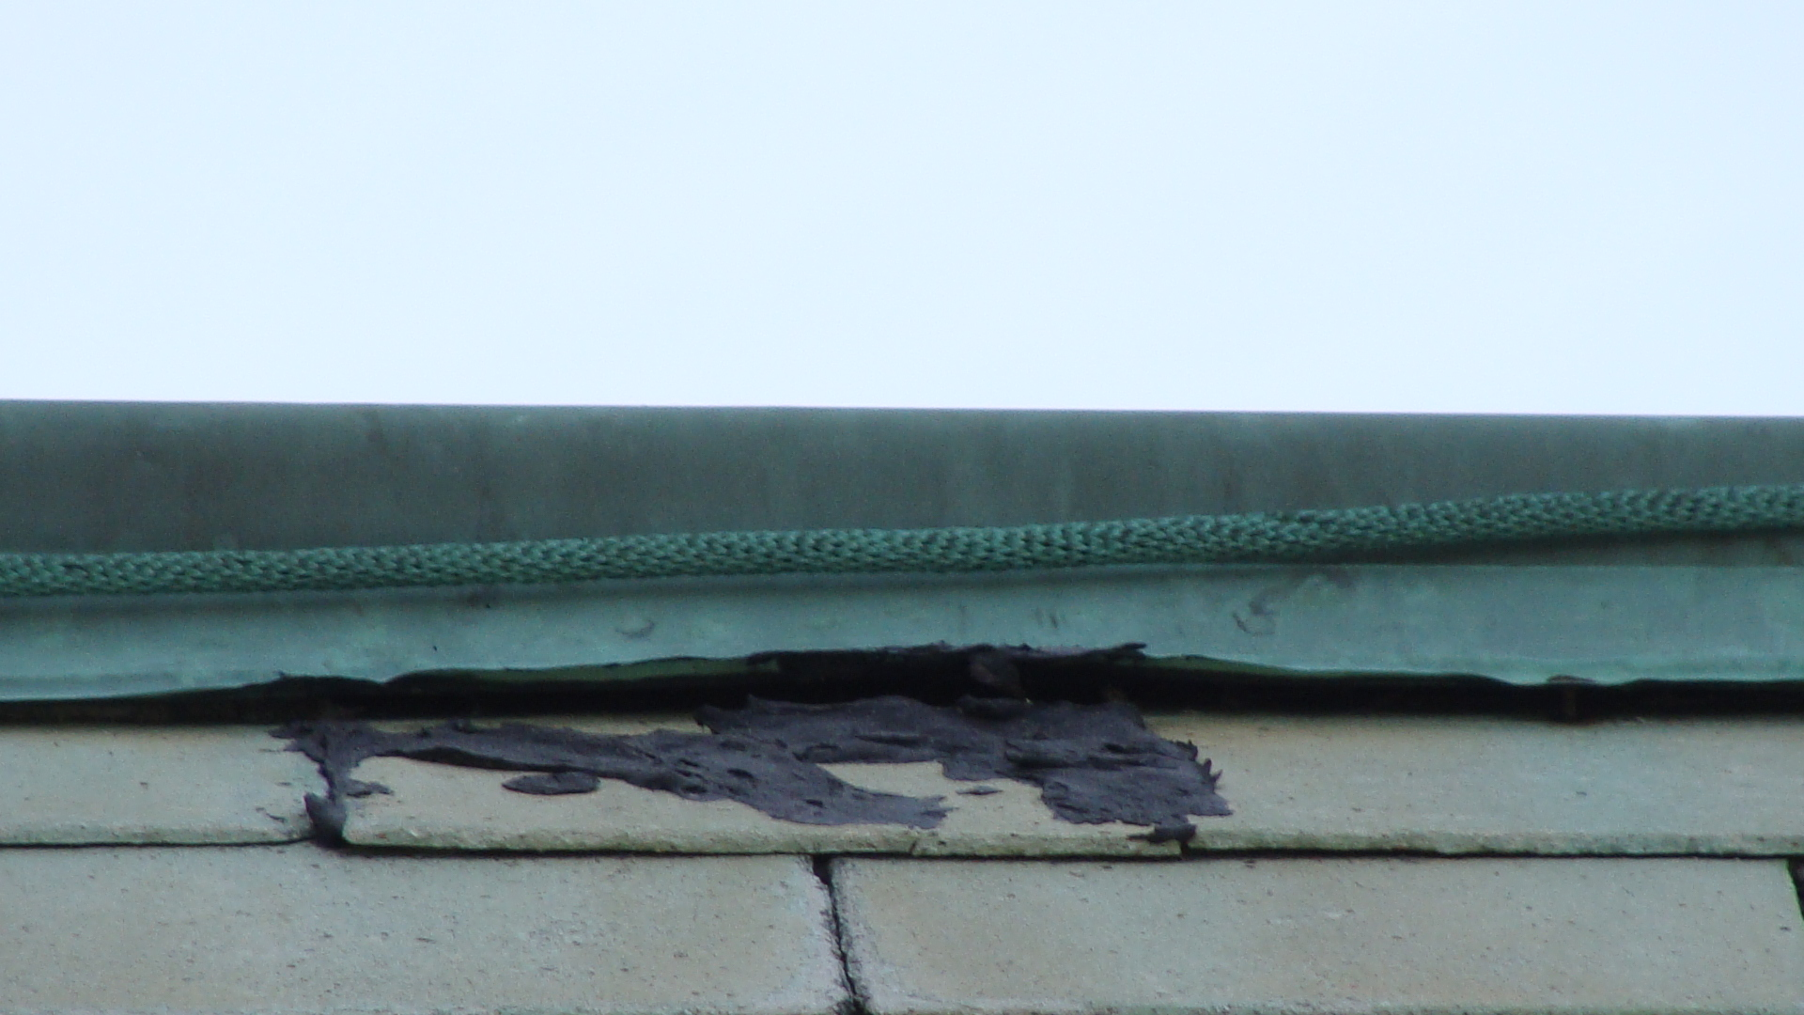
DEFECTIVE COPPER RIDGE CAP

Slide 13
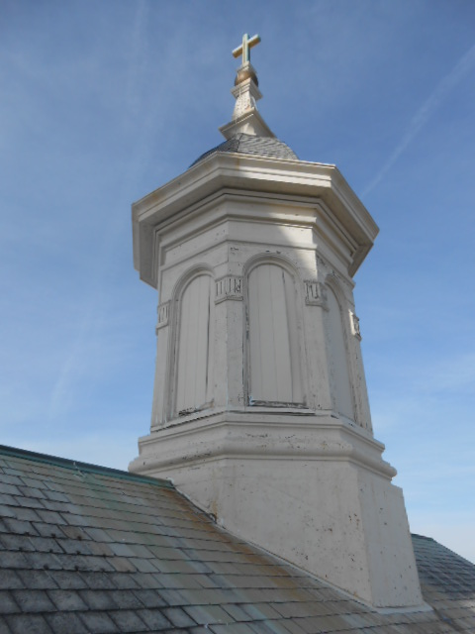
The steel on the cupola shows signs of corrosion which can allow water to leak into the church.

Slide 14
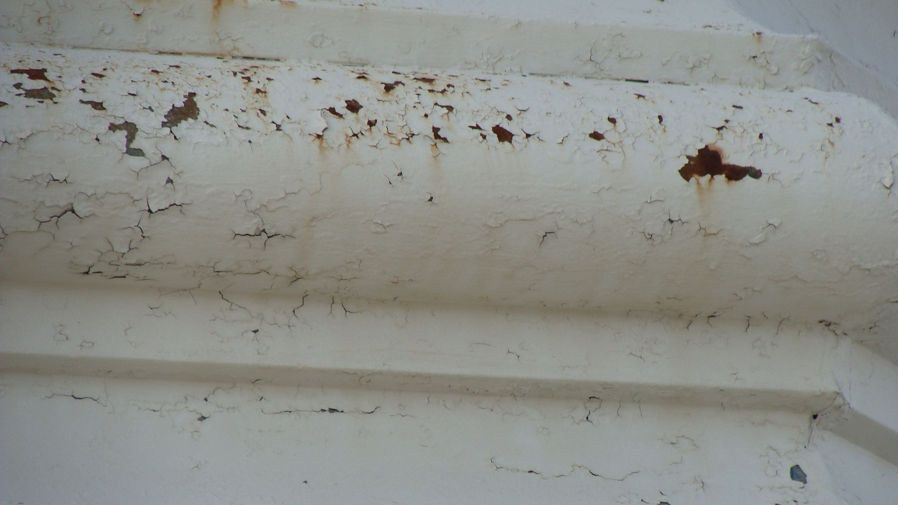
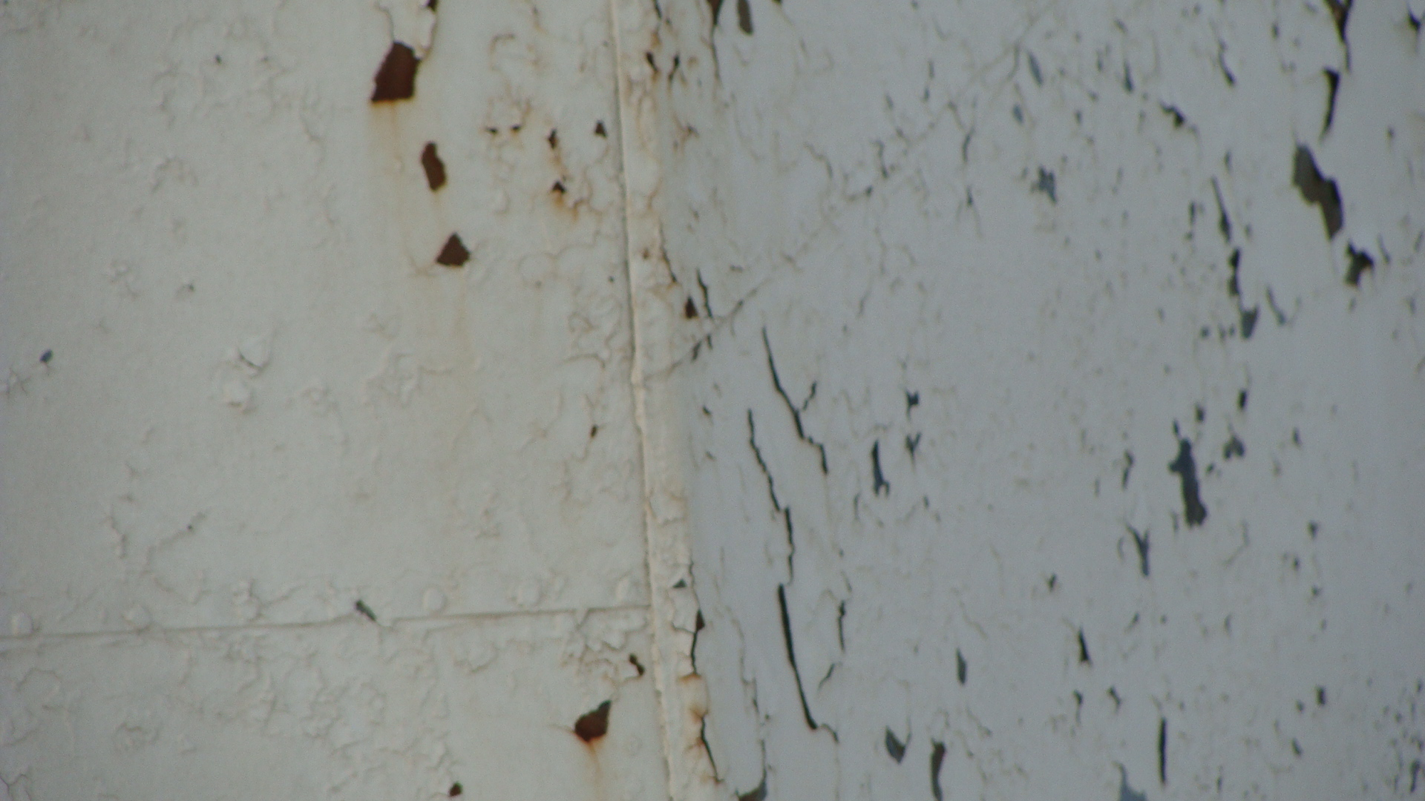
TRIM AND SIDE PANELS WERE CORRODED

Slide 15
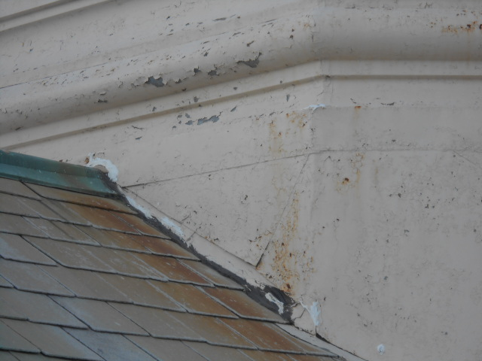
CORROSION ABOVE THE FLASHNGS WAS CRITICAL

Slide 16
THERE IS A SMALLER SECTION OF ROOF ABOVE THE ALTAR

Slide 17
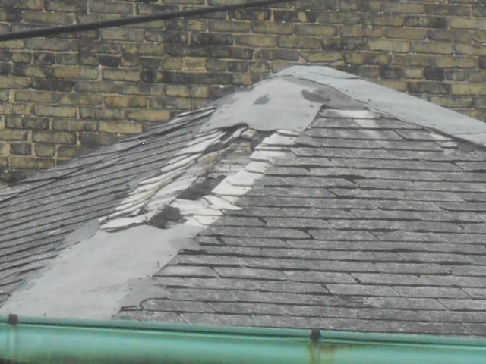
THE HIP CAP SHINGLES ARE HEAVILY DAMAGED

Slide 18
HERE COMES THE WATER!
WIND-DRIVEN RAIN DRAINS INTO BUCKETS IN THE ATTIC.
WATER CAN STAIN & DAMAGE THE PAINT AND PLASTER ON THE CEILING AND WALLS.
WATER CAN DAMAGE PEWS AND CARPETING.
WATER CAN DAMAGE ELECTRICAL AND HVAC COMPONENTS IN THE ATTIC.

Slide 19
WHAT NEEDS TO BE DONE?
REMOVE ASBESTOS SHINGLES, FELT, METAL FLASHINGS & GUTTERS.
RESTORE CUPOLA.
INSTALL NEW ROOFING AND FLASHINGS.
INSTALL NEW GUTTERS AND DOWNSPOUTS.

Slide 20
ROOF REPLACEMENT OPTIONS
1- PREMIUM GRADE ASPHALT SHINGLE
(CERTAINTEED LANDMARK PRO)
2- LUXURY BRAND ASPHALT SHINGLE
(CERTAINTEED GRAND MANOR)
3- SYNTHETIC / COMPOSITE SLATE
(ECOSTAR MAJESTIC SLATE)

Slide 21
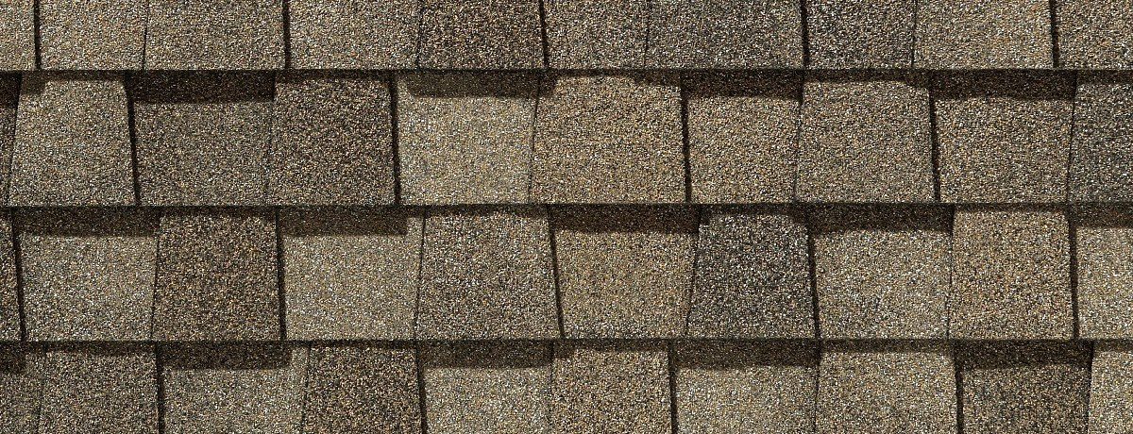
CERTAINTEED LANDMARK PRO (Est 30-YEAR LIFE)
LIFETIME LIMITED MATERIAL WARRANTY

Slide 22
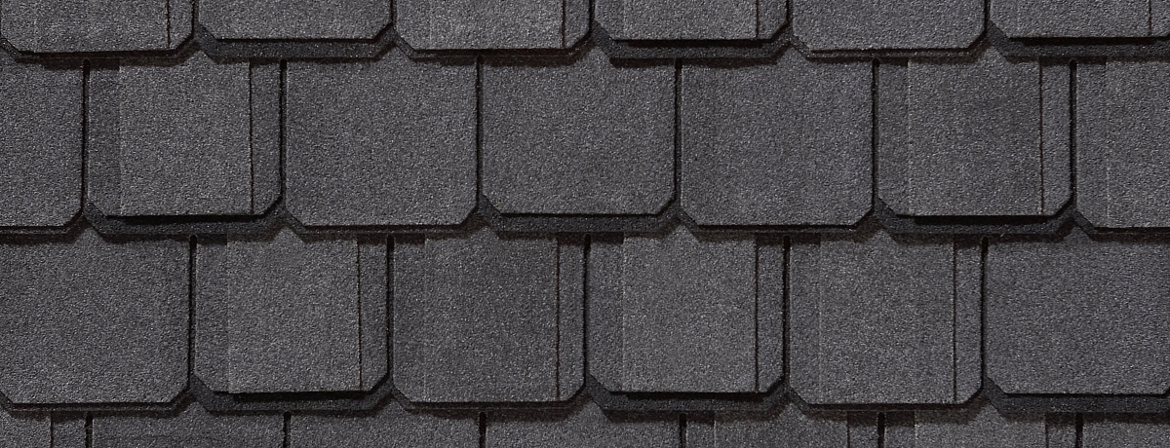
CERTAINTEED GRAND MANOR (EST 40-YEAR LIFE)
LIFETIME LIMITED MATERIAL WARRANTY

Slide 23
ECOSTAR MAJESTIC SLATE (EST 50-YEAR LIFE)
50-YEAR LIMITED MATERIAL WARRANTY

Slide 24
Sheet metal components - new copper valley liners - new ridge cap trim - new flashings

Slide 25
Cupola - replace corroded steel at base of cupola. - SPOT REPAIR OF BALANCE OF CUPOLA. - Replace shingles if money is available.

Slide 26
Gutters - Soldered copper gutters Downspouts - Galvanized steel (discourage theft of copper downspouts)

Slide 27
Scaffolding - Scaffolding would be installed below all roof areas. - Necessary for installing and soldering gutters

Slide 28
TIMING - The roof needs to be replaced as soon as possible. - Prevent interior damage. - MONEY IS A CRITICAL FACTOR.

